Slide 1









My Linear Equations Interactive Notebook
$$×$$
$$\frac{1}{2}$$
$$÷$$
$$+$$
$$−$$
$$\frac{3}{5}$$
$$7$$
Name
Class
Teacher
Term 1 Semester 1
$$5^{2}$$
$$\sqrt{9}$$
1

Slide 2
Contents
Glossary or Formula Page
Page
Date
Description
2
3

Slide 3
Tasks
24
7
30
Essential Question
Questions
Notes
Summary
6
7

Slide 4
24
7
30
Date
Represent word problems with simple linear equations
EQ – How do I Represent word problems with simple linear equations?
7

Slide 5
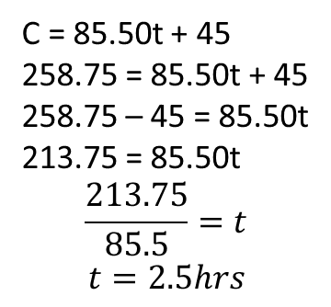
24
7
30
Date
Represent word problems with simple linear equations
EQ – How do I Represent word problems with simple linear equations?
Word to Equation?
The labour cost, $C, for a plumber's visit is given by
C = 85.50t + 45, where t is the time in hours spent by the plumber on the job. If the cost for the plumber's visit was $258.75, for how long was the plumber on the job?
What is the equation we are looking for? Here it is.
C = cost $
T = time – hours
$85.50 = cost per hr
$45 = cost to get there
What are we trying to find? How long means find t.
C = 85.50t + 45
258.75 = 85.50t + 45
258.75 – 45 = 85.50t
213.75 = 85.50t
$$\frac{213.75}{85.5}=t$$
$$t=2.5hrs$$
Note: I’ve put in all lines of working, some can be missed out.
Also note: the answer is 2.5hrs not just 2.5.
You can and do lose marks for just the number.
7

Slide 6
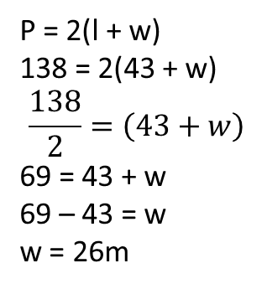
24
7
30
Date
Represent word problems with simple linear equations
EQ – How do I Represent word problems with simple linear equations?
Word to Equation?
2 The perimeter, P, of a rectangle is given by P = 2(l + w), where l is the length and w is the width. If the length of a house block is 43 m and the perimeter is 138 m, what is the width of the house block?
What is the equation we are looking for? Here it is.
P = perimeter 138m
l = length 43m
w = width ?m
What are we trying to find? Width in m.
P = 2(l + w)
138 = 2(43 + w)
$$\frac{138}{2}=\left(43+w\right)$$
69 = 43 + w
69 – 43 = w
w = 26m
Note: Same again I’ve put in all lines of working, some can be missed out.
Again note: the answer is 26m not just 26.
You can and do lose marks for just the number.
7

Slide 7
Exercises
Exercise 2.1 and 2.2 from Dwyer
All to be done with a smile on your faces.

Slide 8
Notes Review
24, 7 ,30
Date
Title
Essential question
Notes complete
Notes complete with colour and diagrams
Questions completed
Contents page filed in
Formula page filled in

Slide 9
Homework
Review your notes and write a summary answering the essential question.

